Slide 1
ARL ParaPower Fundamentals
Dr. Lauren Boteler, Dr. Mike Fish, Mr. Morris Berman
DISTRIBUTION STATEMENT A: Approved for public release.
U.S. Army Research Laboratory

Slide 2
Outline
ARL ParaPower Fundamentals
Features
Material Types
Internal Boundary Cavities (IBCs)
Time Varying Heating
ParaPower Code Structure
Convergence

Slide 3

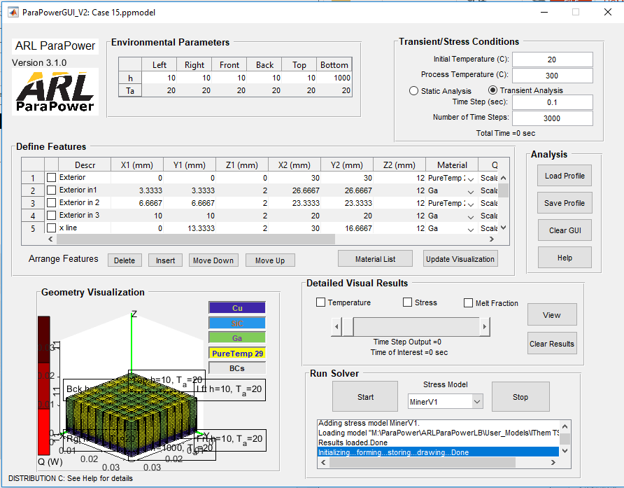
Codesign – Parametric Analysis (ParaPower)
Problem Statement: It is critical that the time required to understand a complete multi-disciplinary parametric space is reduced, this will eliminate overdesign in power modules and improve SWaP-C.
Objective: Develop a thermal transient tool that can support the military and the industry to quickly develop optimized power packages.
ARL’s ParaPower tool
Compact 3D thermal resistance and stress network model
Quickly analyze large multi-disciplinary parameter space
>100X faster solution time with reasonable accuracy
Simple node temperature and stress output
Notes:
Current SOA:
CAD tools can do feedback (ex. ANSYS Workbench) but large parametric space is difficult
Work in co-design at the chip level (TSV, TTSV, microchannel, electrical co-design)
Electro-mechanical work at the board level
No work in power modules or to the level proposed
ARL has published work on the thermal aspect

Slide 4
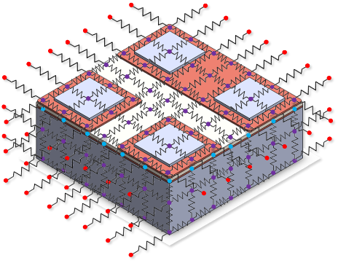
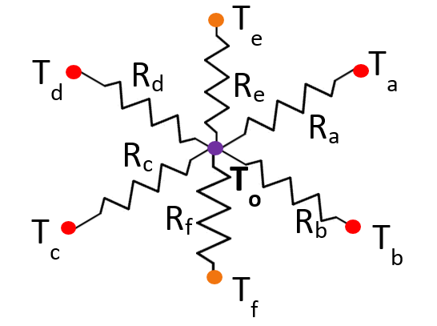


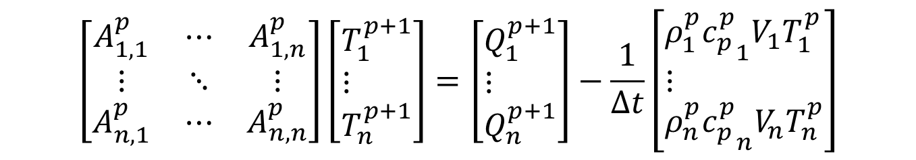
ParaPower Finite Difference
p = time step number
n = number of elements
Δt = time step (sec)
ρ = density
c_{p} = specific heat
V = element volume
Single Node Resistance Network
$$\left[\begin{aligned}&T_{1}^{p+1} \\ &⋮ \\ &T_{n}^{p+1}\end{aligned}\right],\left[\begin{aligned}&φ_{1}^{p} \\ &⋮ \\ &φ_{n}^{p}\end{aligned}\right]→\left[\begin{aligned}&φ_{1}^{p+1} \\ &⋮ \\ &φ_{n}^{p+1}\end{aligned}\right]$$
$$\left[\begin{matrix}A_{1,1}^{p} & ⋯ & A_{1,n}^{p} \\ ⋮ & ⋱ & ⋮ \\ A_{n,1}^{p} & ⋯ & A_{n,n}^{p}\end{matrix}\right]\left[\begin{aligned}&T_{1}^{p+1} \\ &⋮ \\ &T_{n}^{p+1}\end{aligned}\right]=\left[\begin{aligned}&Q_{1}^{p+1} \\ &⋮ \\ &Q_{n}^{p+1}\end{aligned}\right]−\frac{1}{Δt}\left[\begin{aligned}&ρ_{1}^{p}{c_{p}^{p}}_{1}V_{1}T_{1}^{p} \\ &⋮ \\ &ρ_{n}^{p}{c_{p}^{p}}_{n}V_{n}T_{n}^{p}\end{aligned}\right]$$
Thermal capacitance term

Slide 5
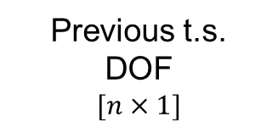
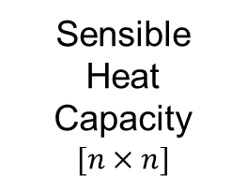



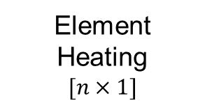

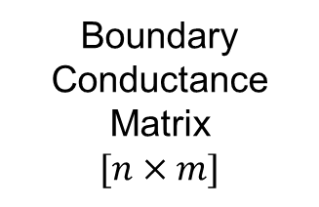
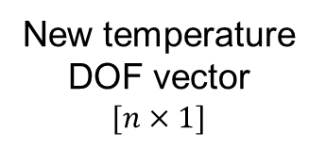
ParaPower Finite Difference
To move from timestep $(p)$ to $(p+1)$:
In a model with $n$ solid elements
Sensible Heat Capacity
$$[n×n]$$
New temperature DOF vector
$$[n×1]$$
Previous t.s.
DOF
$$[n×1]$$
$$\left(A+C\right)T^{(p+1)}={BT}_{a}+CT^{(p)}+Q$$
Single Node Resistance Network
Steady
Conductance
Matrix
$$[n×n]$$
Element Heating
$$[n×1]$$
Boundary Conductance
Matrix
$$[n×m]$$
Ambient Temperature Vector
$$[m×1]$$
$$C=diag\left(C\right)={\left(ρC_{p}\right)}_{ii}/V_{ii}$$

Slide 6

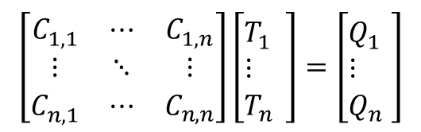
Integrate stress into model
Combine
Thermal Analysis & Stress Analysis
Stress in the substrate:
$$σ_{s}=E_{s}\left(ε−α_{s}∆T\right)$$
Stress in individual film layers:
$$σ_{i}=E_{i}\left(ε−α_{i}∆T\right)$$
$$ε=c+\frac{z−t_{b}}{r}$$
Total Strain
Bending Strain
Single Node Resistance Network
E – Modulus of elasticity
α –CTE
c – Uniform component of strain
t_{b} – Bending axis location
z – Vertical location in the substrate/film stack
r – Radius of curvature
$$\left[\begin{matrix}C_{1,1}^{} & ⋯ & C_{1,n}^{} \\ ⋮ & ⋱ & ⋮ \\ C_{n,1}^{} & ⋯ & C_{n,n}^{}\end{matrix}\right]\left[\begin{aligned}&T_{1}^{} \\ &⋮ \\ &T_{n}^{}\end{aligned}\right]=\left[\begin{aligned}&Q_{1}^{} \\ &⋮ \\ &Q_{n}^{}\end{aligned}\right]$$
Stress model is substrate dependent (significant thickness and dominates stress model), appropriate for power electronics.
Network nodes confined to single material
Can vary number of nodes in each material
Hsueh, C. H., “Thermal Stress in Elastic Multilayer Systems,” Thin Solid Films, vol 418, pp 182 – 188, 2002.

Slide 7
Outline
ARL ParaPower Fundamentals
Features
Material Types
Internal Boundary Cavities (IBCs)
Time Varying Heating
ParaPower Code Structure
Convergence

Slide 8
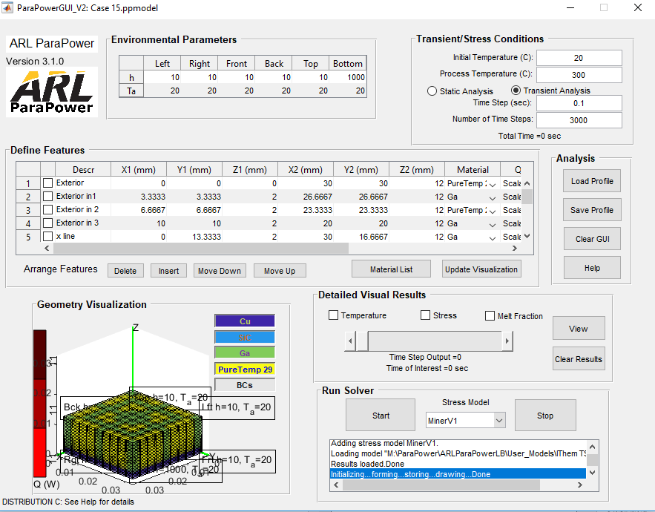
Feature Based GUI
Transitioned the GUI from Layers to Features

Slide 9
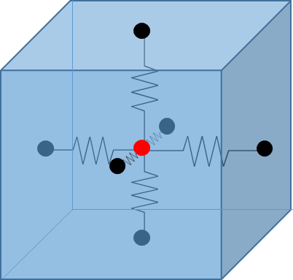
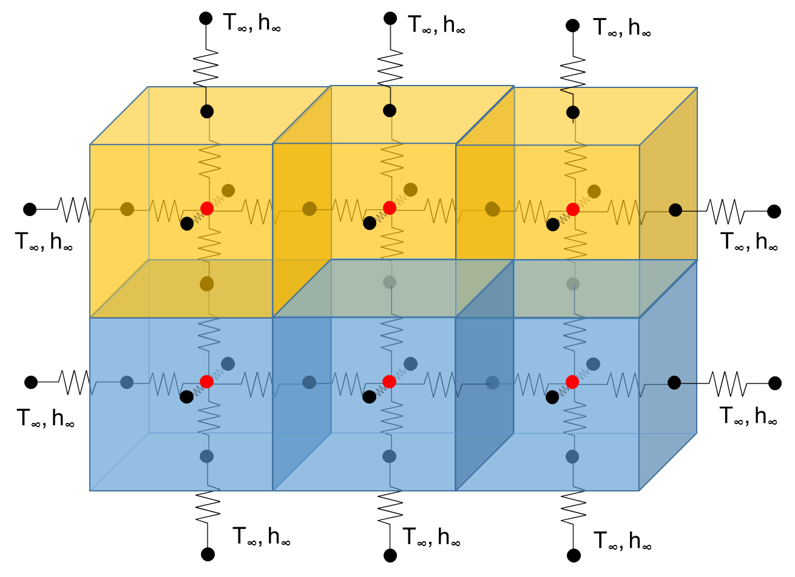
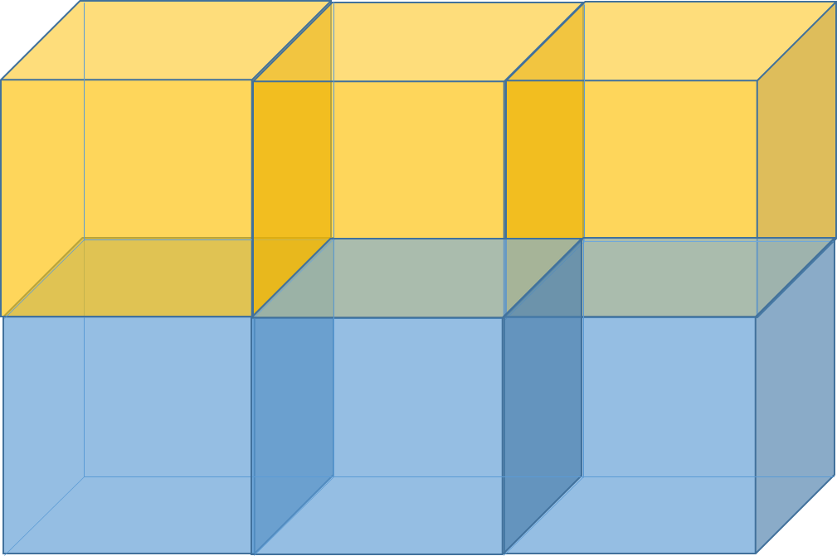
fEATURES
Everything is defined as a feature, each feature is subdivided into elements and each element comprises a 3D resistor network.
Element
Feature 1
Feature 2

Slide 10
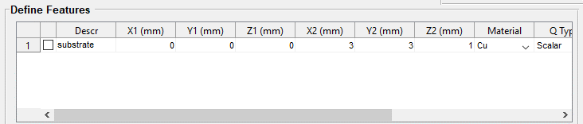
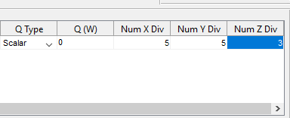
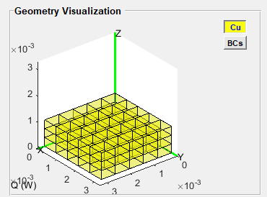
Features
Each feature is defined by
(X1, Y1, Z1) and (X2, Y2, Z2)
Material
Heat
Num X, Num Y, Num Z

Slide 11


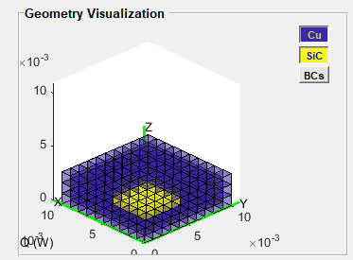
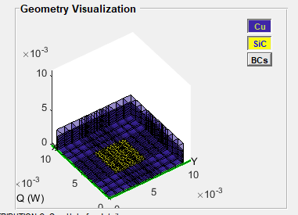

Features Continued
Subsequent features overwrite previous features
All divisions intersect each other
Can put divisions on largest elements and then nothing else
Error trapping to remove any feature that is >2 orders of magnitude smaller than the smallest feature

Slide 12
Outline
ARL ParaPower Fundamentals
Features
Material Types
Internal Boundary Cavities (IBCs)
Time Varying Heating
ParaPower Code Structure
Convergence

Slide 13
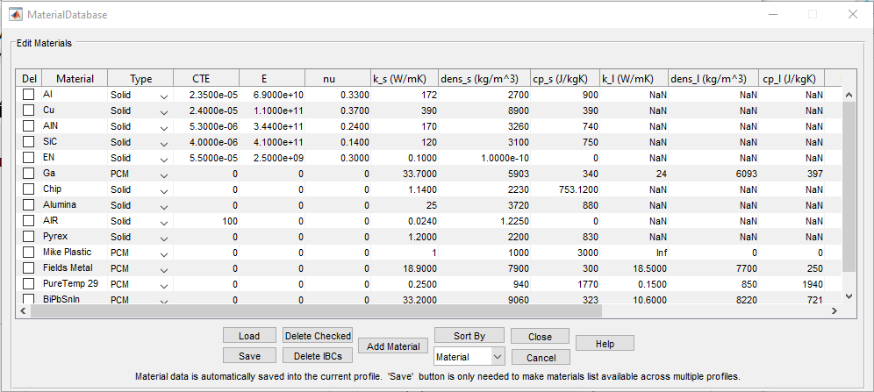
Materials database

Slide 14
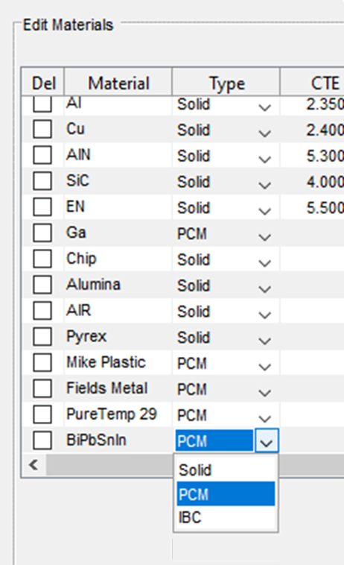
4 types of materials
Solid
Stress properties: CTE, E, nu
Thermal solid phase properties: thermal conductivity, density, specific heat
PCM
Solid properties +
Thermal liquid phase properties: thermal conductivity, density, specific heat
Latent heat
Melting temperature
IBC
Ambient temperature
Heat transfer coefficient

Slide 15
Outline
ARL ParaPower Fundamentals
Features
Material Types
Internal Boundary Cavities (IBCs)
Time Varying Heating
ParaPower Code Structure
Convergence

Slide 16
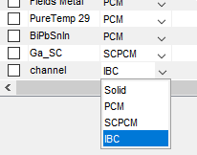
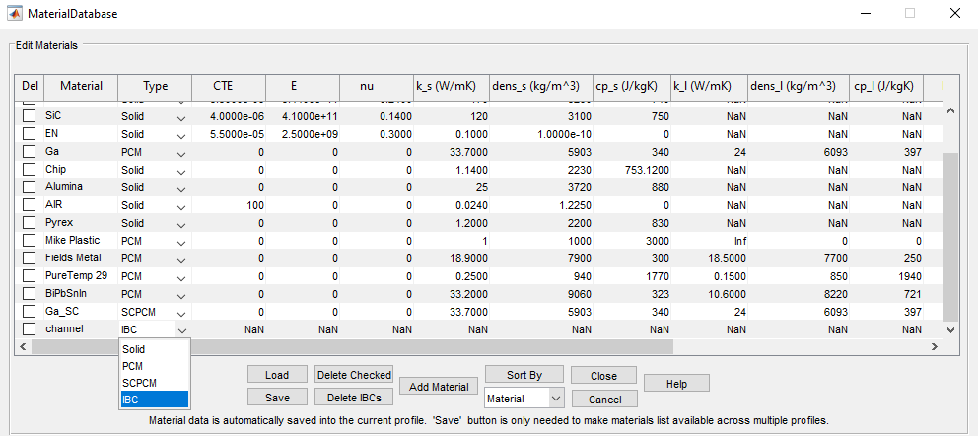
New feature: IBCs
Internal node:
IBC node:
Internal Boundary Cavities (IBCs)
Features that are defined by a heat transfer coefficient and an ambient temperature
Used for heat sinks, voids, etc.
Allows
heat sinks anywhere
Agnostic geometries

Slide 17
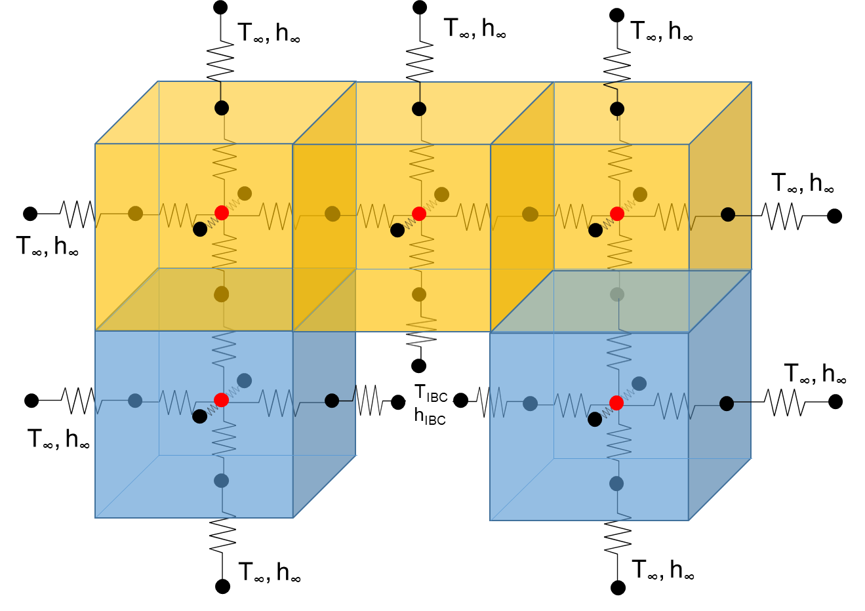
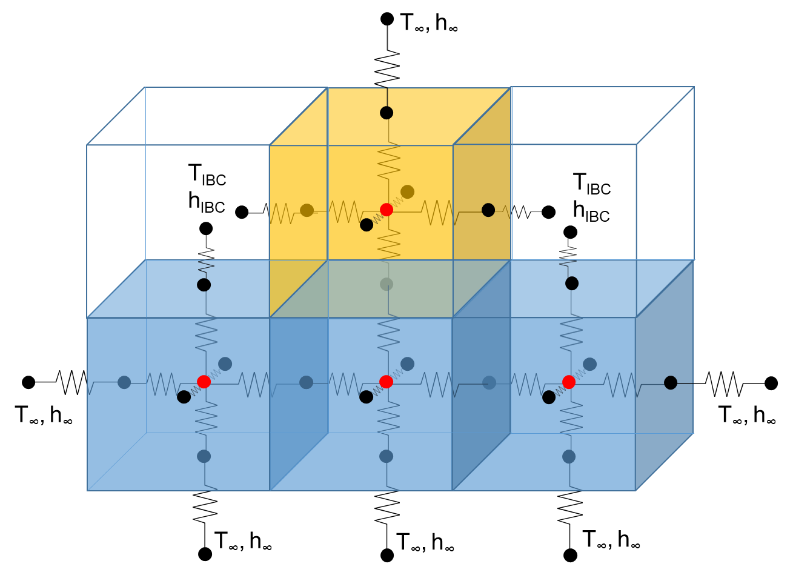
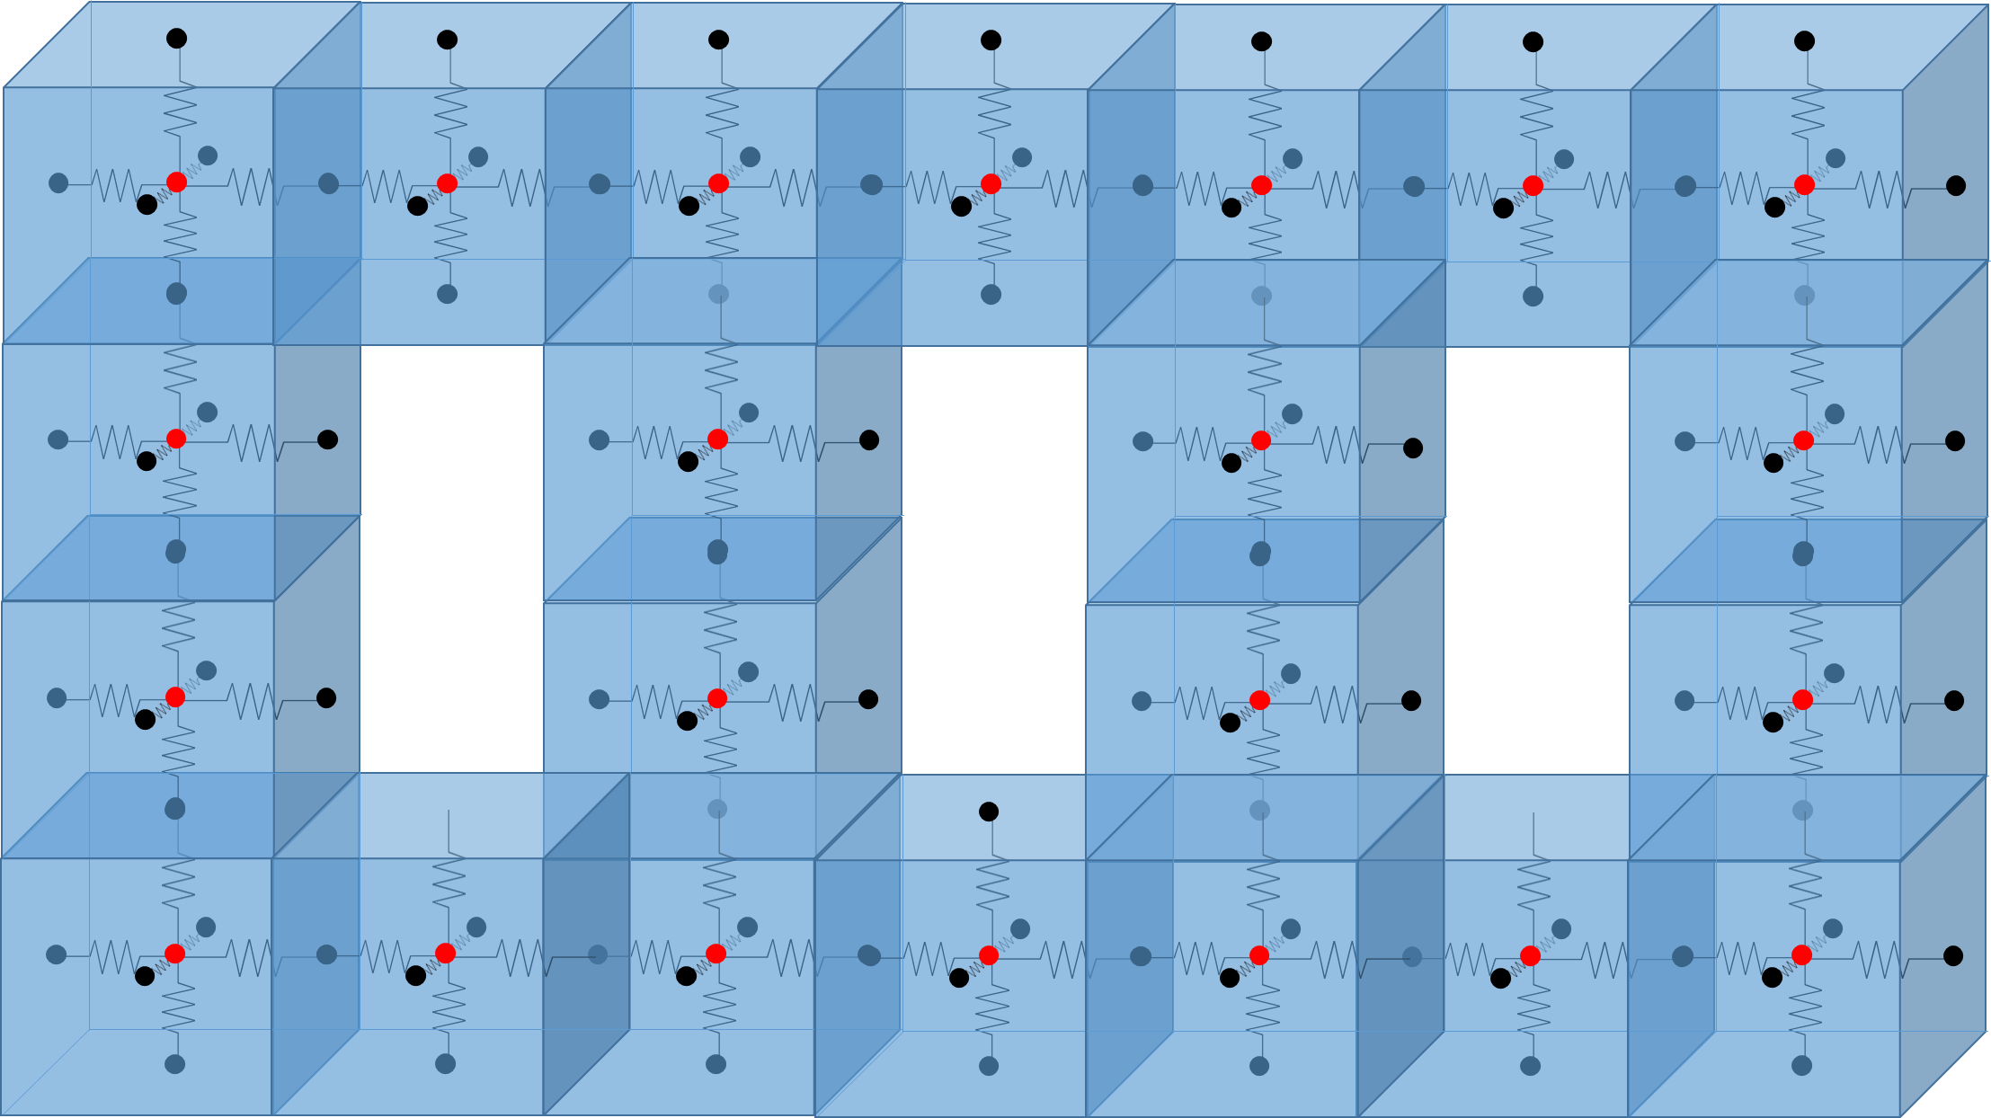
IBC Example locations
Agnostic Geometries
Heat Sinks/Internal Channels

Slide 18
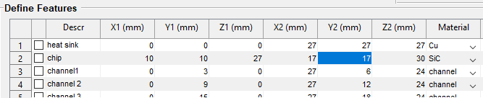
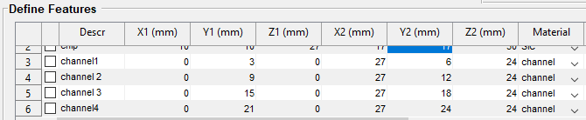
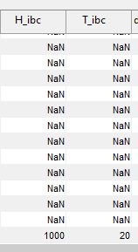
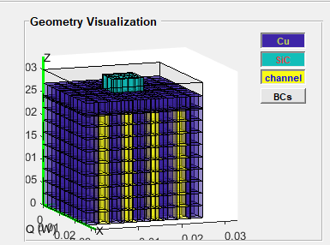
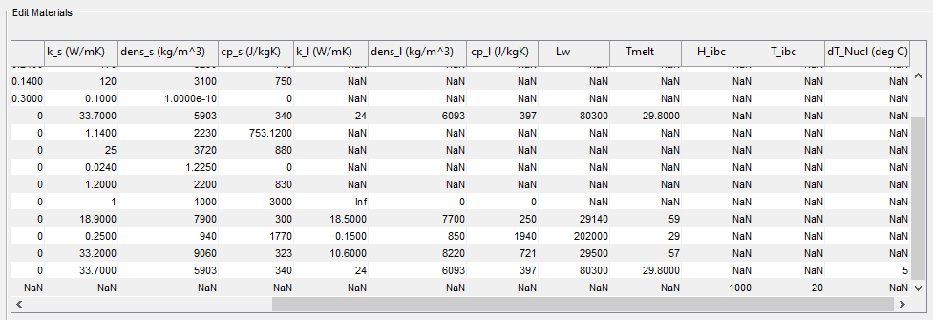
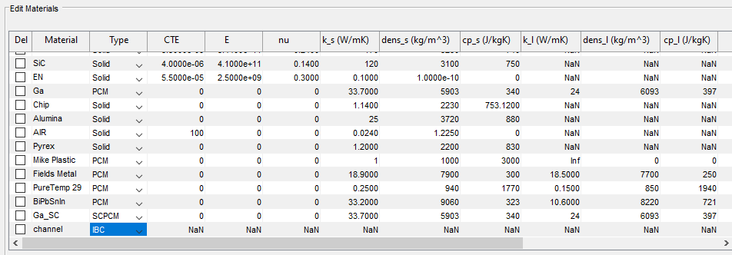
IBC heat sinks

Slide 19
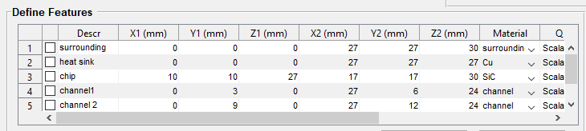
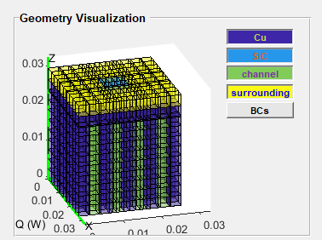
Agnostic Geometries
Due to the nature of the solver, the entire box must be defined. Any volume not defined is automatically defined as adiabatic
If adiabatic is not desirable, simply put a bounding box of an IBC that is the desired condition
Undefined volume defaults to adiabatic
Surrounding is IBC defined as h=10 and T=20

Slide 20
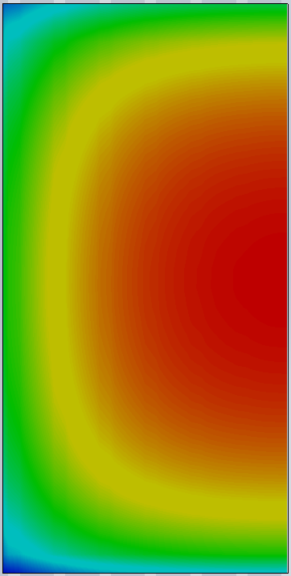
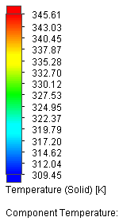
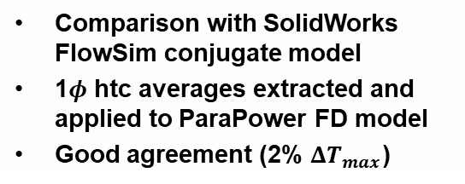
Validating IBC results
Interior regions that can be designated as fluid volumes
Modeled as a bulk fluid temp and htc
Surface temperature of heated component
20 °C fluid inlet
Comparison with SolidWorks FlowSim conjugate model
1$φ$ htc averages extracted and applied to ParaPower FD model
Good agreement (2% $ΔT_{max}$)

Slide 21
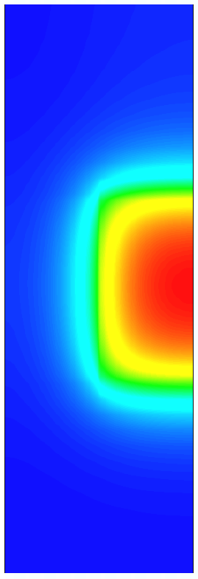
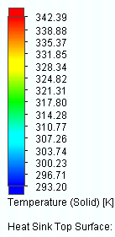
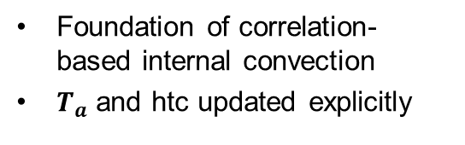
Interior Voids
Foundation of correlation-based internal convection
$T_{a}$ and htc updated explicitly
Surface temperature heatsink baseplate
20 °C fluid inlet

Slide 22
Outline
ARL ParaPower Fundamentals
Features
Material Types
Internal Boundary Cavities (IBCs)
Time Varying Heating
ParaPower Code Structure
Convergence

Slide 23
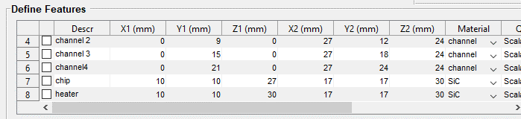
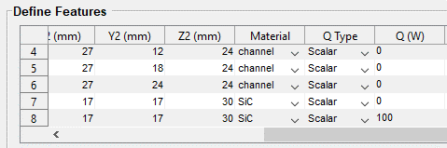
Applying heat
When defining features, optionally define a heat (Q) in Watts
Volume = W/cm3
Plane = W/cm2
Can add a zero thickness layer to get a W/cm2
7mm x 7mm chip with 100W of heat → 204W/cm²

Slide 24
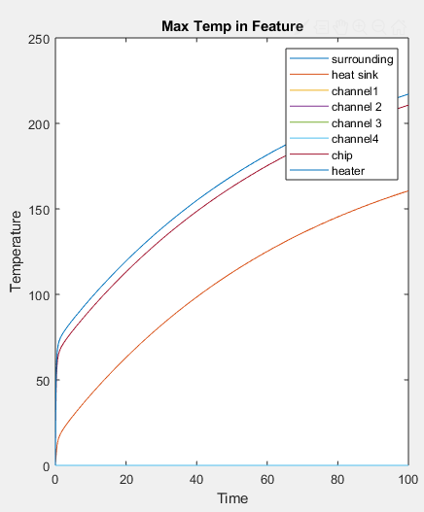
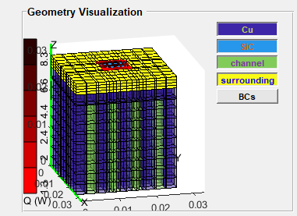
Results from set up
Each feature outputs a temperatures versus time plot
5 second run time
0.1 sec time step
1000 iterations
h_wall = 300

Slide 25
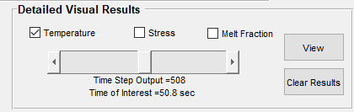
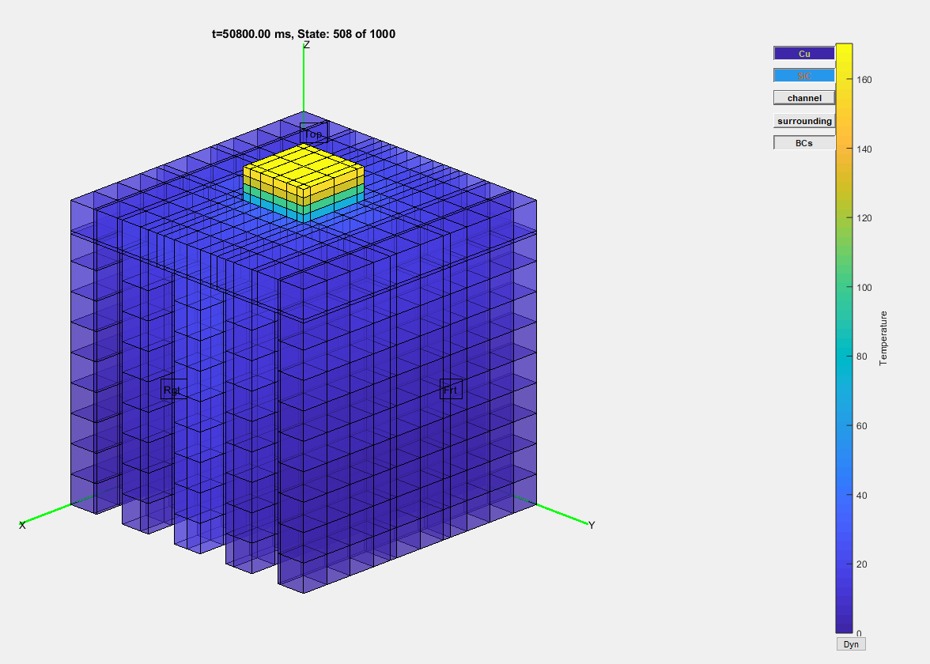
Detailed visual results
The temperature versus time plot is generated automatically, detailed visual results are also available at all time steps

Slide 26
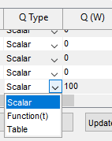


Time dependent heating/cooling
There are 3 types of heating conditions
Scalar
Function (t)
Table
Defined individually for each feature

Slide 27

Time dependent heating/cooling

Slide 28
Outline
ARL ParaPower Fundamentals
Features
Material Types
Internal Boundary Cavities (IBCs)
Time Varying Heating
ParaPower Code Structure
Convergence

Slide 29
ARL Parapower code structure Current Datastructures
Basic GUI Flow
MaterialDatabase
ModelInformation Structure
Geometry
Heat Source Q(t)
BC’s
Material Database
Stress Model (dir)
TestCaseModel Structure
External Conditions
Features
Parameters
Material Database
Results
Stress (t)
Visualize.m
ParaPowerThermal.m
Save
TestCaseModel
ModelInformation
Stress
Temperature
MeltFraction
Results
Temperature (t)
MeltFraction (t)
FormModel.m
Structure
Function
GUI Operation

Slide 30
Formmodel.m
Input
ExternalConditions on each model face
ambient temperature
heat flux
Features
rectangular volumes
specified X, Y, Z divisions define element size
heat source (constant or time dependent)
Parameters
time stepping
initial temperature
processing temperature (not currently used to compute prestress)
Materials
3 Types: solid, phase change material, internal boundary condition
stored in encapsulated database with distinct GUI and independent load/save abilities
Function
Translate individual features into a single unified geometry

Slide 31
Solvers
ParaPowerThermal
Compute temperature and melt fraction states over given time steps
Input
Geometry - single matrix with each element having an identified material type
Heat source – single matrix of function handles that define Q(t) for each element
Boundary conditions – includes time vector
Material library – carries material properties and element initialization and behavioral characteristics based on type
stress_MinerV1
Initial stress model computes stress state as a function of time
Input
Same as above
Temperature states

Slide 32

Visualize
Provides for flexible visualization of ModelInformation and state information.
Rotatable/Scalable
Dynamic or fixed color scale
Any material can be
Solid elements
Edge only element
Single face of element (left, front, etc)
Masked
Element transparency adjustable
Linearly interpolated or single color per element

Slide 33
ARL parapower code structure in-process updates
Code is under GIT version control hosted at a DoD repository
Materials, TestCase, ModelInformation, Results being reformulated into objects
Increased flexibility (element types: IBC, supercooling, etc)
Improved implicit program documentation
Maintainability
Data Encapsulation
Shared codebase with Simulink compatibility
Simulink Integration
Solver implemented as Matlab system object
Programmatic model definition
Model Input – IBC boundary temps
Model Output – IBC heat flux

Slide 34
Outline
ARL ParaPower Fundamentals
Features
Material Types
Internal Boundary Cavities (IBCs)
Time Varying Heating
ParaPower Code Structure
Convergence

Slide 35


PCM Melt Validation
ParaPCM tool compared to ANSYS simulation results (<5% error in 1 sec)
1D ARL PCM
Convergence time (sec)
0.48 | 0.24 | 0.12 | 0.06 | 0.03 | 0.02 | 0.01 | 0.01 | 0.01
1.06 | 0.53 | 0.28 | 0.14 | 0.07 | 0.04 | 0.02 | 0.01 | 0.01
2.76 | 1.34 | 0.70 | 0.35 | 0.18 | 0.09 | 0.05 | 0.03 | 0.02
8.85 | 4.31 | 2.25 | 1.10 | 0.54 | 0.28 | 0.14 | 0.08 | 0.04
31.88 | 15.94 | 8.26 | 4.03 | 1.98 | 1.01 | 0.51 | 0.27 | 0.14
126.37 | 60.83 | 32.12 | 17.48 | 7.78 | 3.98 | 1.94 | 1.05 | 0.51
545.17 | 265.07 | 136.65 | 65.08 | 33.52 | 17.14 | 8.49 | 4.40 | 2.13
2468.87 | 1246.23 | 613.01 | 308.17 | 159.32 | 78.46 | 38.93 | 20.29 | 9.62
12611.26 | 6451.08 | 3165.98 | 1618.00 | 807.28 | 401.21 | 204.77 | 103.01 | 50.44

Slide 36

Compare to exact 1D solution: Timestep
1ms →
ΔT = 0.09°C
runtime = 2ms
100ms →
ΔT = 1°C
runtime = 0.04ms
Error metrics and runtime for different timesteps
Notes:
If a linear problem, the order of convergence should be 1 (linear problem) , there is a diminishing return to smaller timestpes – this is unexpected if a linear problem.

Slide 37
Compare to exact 1D solution: grid spacing
0.01mm →
Max ΔT = 0.02°C
RMS ΔT = 0.05°C
runtime = 3 ms
1mm →
Max ΔT = 4°C
RMS ΔT = 2°C
runtime = 1 ms
L₂ norm and runtime for grid spacing
Notes:
Discretization error is no longer linked to

